Slide 1


LLM EXPERIMENTS WITH THE SCIENCE MUSEUM COLLECTIONS
DANIEL BELTEKI COLLECTIONS DATA SCIENTIST
DOCUMENTATION TEAM
5 FEBRUARY 2026

Slide 2
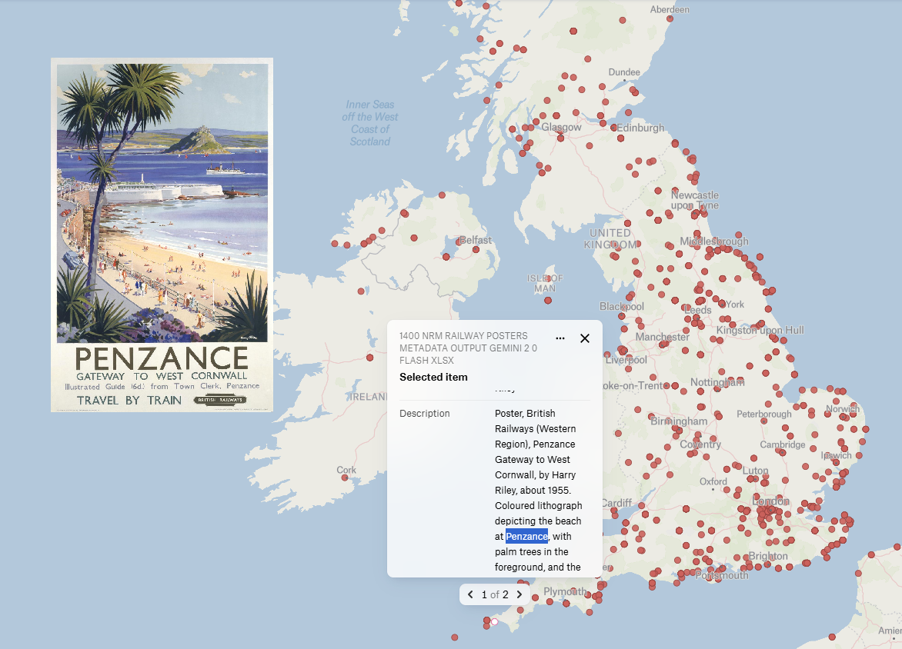
Getty TGN format generated output:
Europe, United Kingdom, England, Cornwall, Penzance

Slide 3
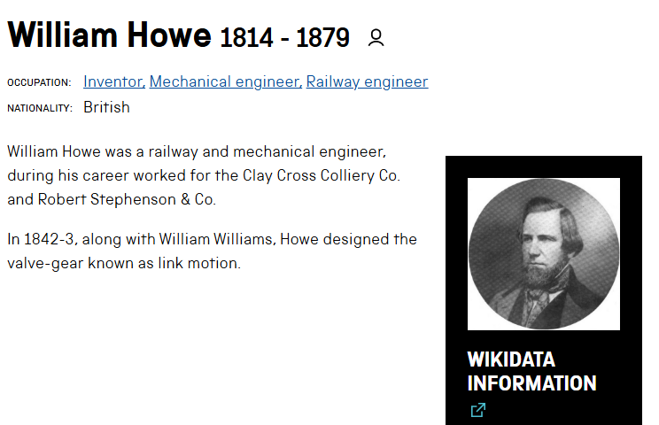
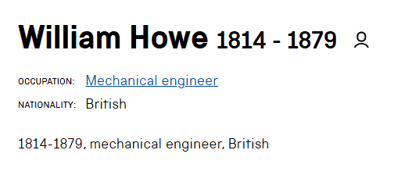
DUPLICATES IDENTIFICATION AND EVALUATION
113 duplicate entry pairs identified intra-system published on Collections Online
665 duplicate entry pairs across systems published on Collections Online
222 wrong Wikidata matches
967 entry matches with The Royal Society Past Fellows dataset (approx. 500 added to Wikidata)
Example justification statement for William Howe (cp43296 vs cp46197): “Same name, birth date, and death date strongly suggest the same person. The differing ID and minor variations in bio and occupation descriptions are likely due to database discrepancies or differing levels of detail. Description provides supporting information.”
Person1_Data | Person1_ID | Person2_Data | Person2_ID
Dr.ALEXANDER | cp77702 | Dr.ALEXANDER | cp136348
AMALGAMATED DENTAL COMPANY LIMITED | cp86033 | AMALGAMATED DENTAL COMPANY LIMITED | cp111188
ACADEMIE DES SCIENCES | cp85219 | ACADEMIE DES SCIENCES | cp90500
BLUNT, THOMAS | cp10743 | BLUNT, THOMAS | cp43434
ELLISTON, HARRY | cp614 | ELLISTON, HARRY | cp615
HOWE, WILLIAM | cp43296 | HOWE, WILLIAM | cp46197
LANCASHIRE & YORKSHIRE RAILWAY | cp2826 | LANCASHIRE & YORKSHIRE RAILWAY | cp160050
MOORE, JOSEPH | cp111485 | MOORE, JOSEPH | cp108479
ROYAL SWEDISH ACADEMY OF SCIENCES | cp88192 | ROYAL SWEDISH ACADEMY OF SCIENCES | cp93474
RIETZSCHEL | cp101558 | RIETZSCHEL | cp102243
SERVICES ELECTRONICS RESEARCH LABORATORY | cp22340 | SERVICES ELECTRONICS RESEARCH LABORATORY | cp51370
THOMSON, J H | cp15686 | THOMSON, J H | cp57589
THORP, THOMAS | cp45967 | THORP, THOMAS | cp29915
WETMORE, ROBERT | cp20811 | WETMORE, ROBERT | cp31392
WOHLER, FRIEDRICH | cp37774 | WOHLER, FRIEDRICH | cp91041

Slide 4
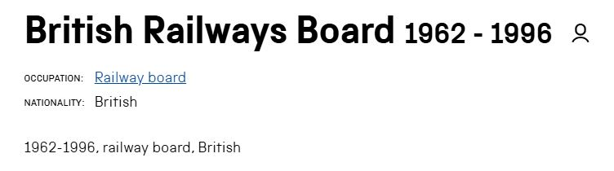
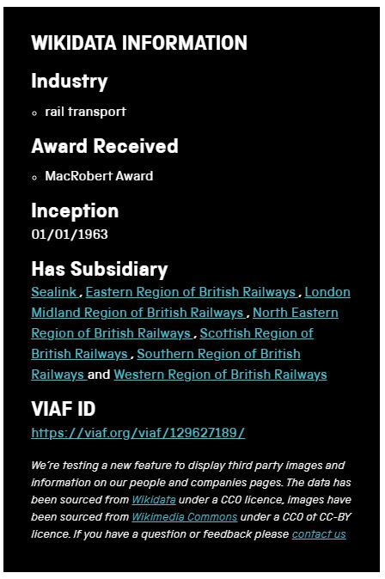
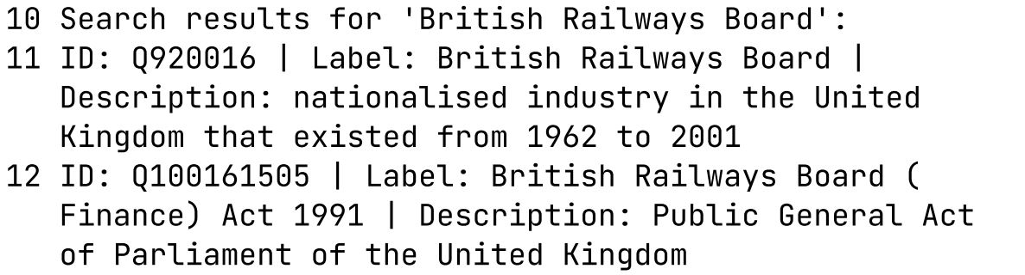
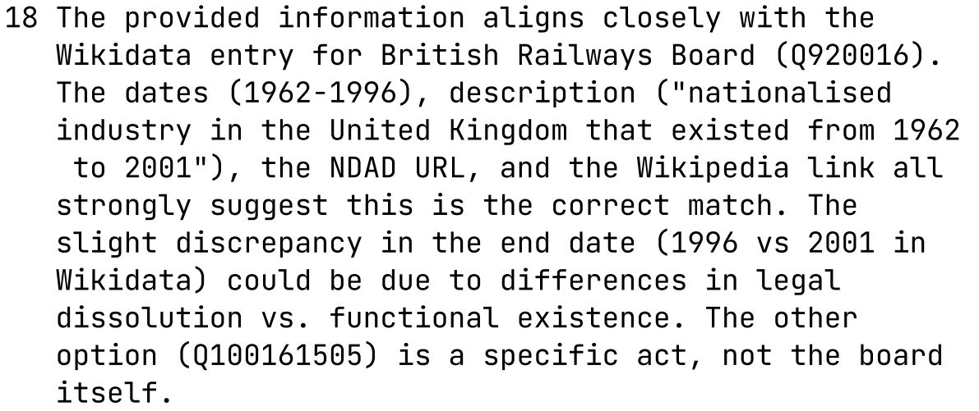
WIKIDATA LINKAGES EVALUATION WITH LARGE LANGUAGE MODELS
WIKIDATA SEARCH
LLM PROMPT
Adding information from Mimsy fields: - PREFERRED_NAME / SORT_NAME - BRIEF_BIO / DESCRIPTION - BIRTH_DATE / DEATH_DATE - OCCUPATION - NATIONALITY etc.

Slide 5
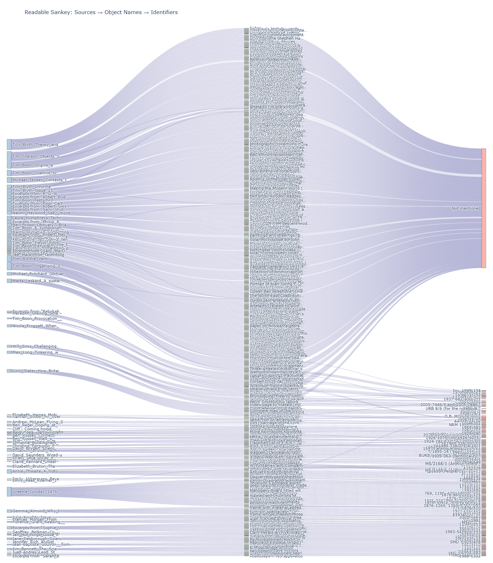
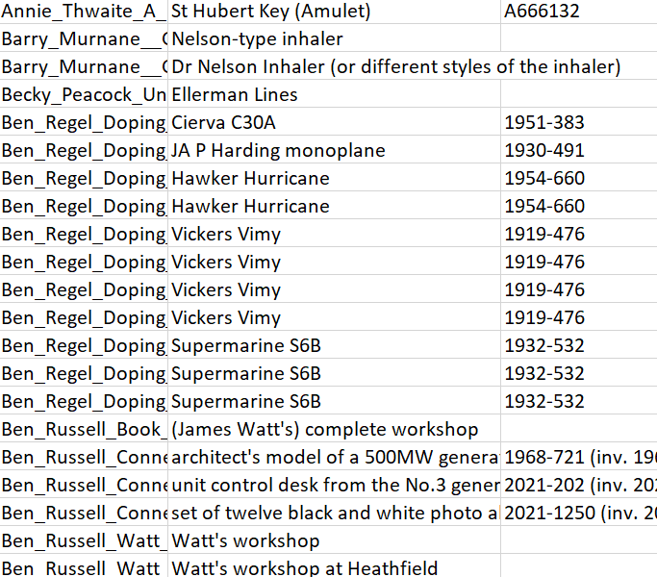
OBJECTS MENTIONED IN SCIENCE MUSEUM GROUP JOURNAL

Slide 6
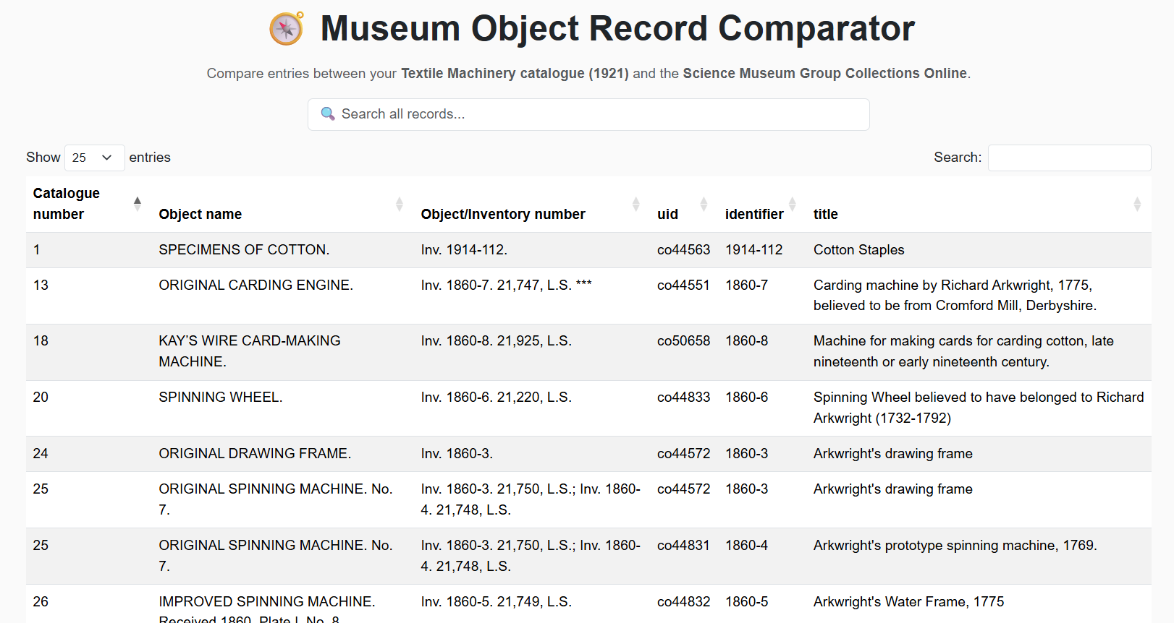
HISTORIC CATALOGUES OBJECT IDENTIFICATION
66 (out of 138) digitised historic catalogues identified
11 historic catalogues transformed into digital datasets
2,346 historic catalogue entries identified and processed
c, 1,500 objects matched to historic catalogue entries
Platform comparing the information-richness of old and new entries

Slide 7
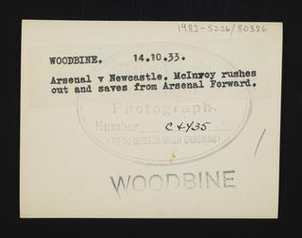
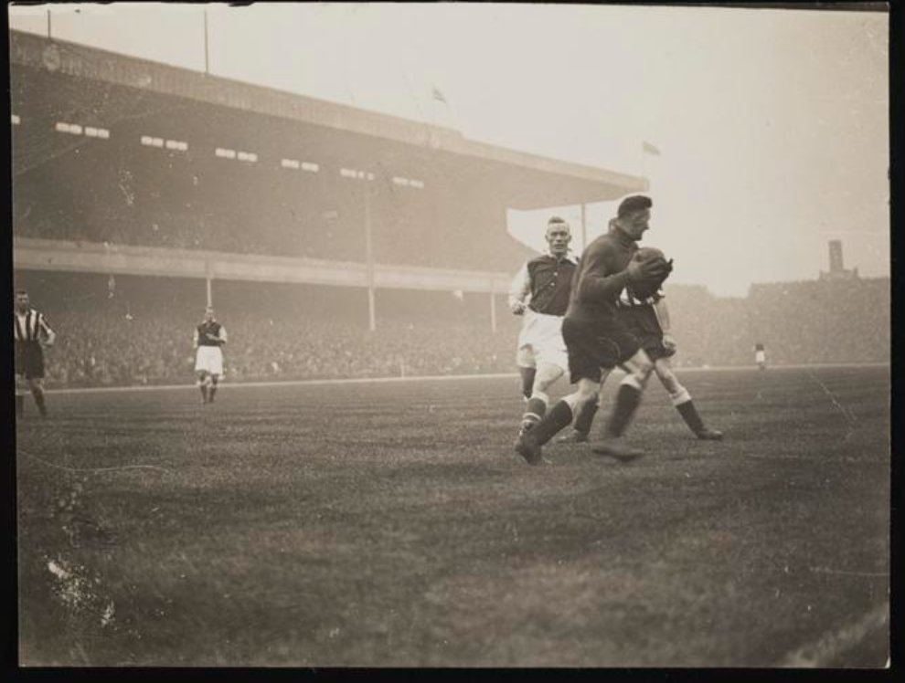
DAILY HERALD
Photos published on Collections Online without captions (& Unpublished photos)
Transcription of the backs of photographs (Gemini)
Assessing accuracy and behaviour of tool
Image size requirements – large images needed
Photographer | Collections Online | Transcription | %
James Jarche | 90 | 812 (+722) | (+802%)
George Woodbine | 220 | 983 (+763) | (+346%)
Edward Malindine | 126 | 1920 (+1,794) | (+1,423%)
Leslie Cardew | 394 | 1836 (+1,442) | (+465%)
Saidman | 850 | 969 (+119) | (+14%)
Reg Sayers | 118 | 424 (+306) | (+259%)
TRANSCRIPTION OUTPUT FOR
IMAGE co8876935 (1983-5236/80386) Title: “A photographic print of Sports, Football, League Matches, 1933”
1983-5236/80396
WOODBINE. 14.10.33.
Arsenal v Newcastle. Mclnroy rushes out and saves from Arsenal Forward.
Photograph.
Number C4435
TO BE QUOTED WHEN ORDERING
WOODBINE

Slide 8
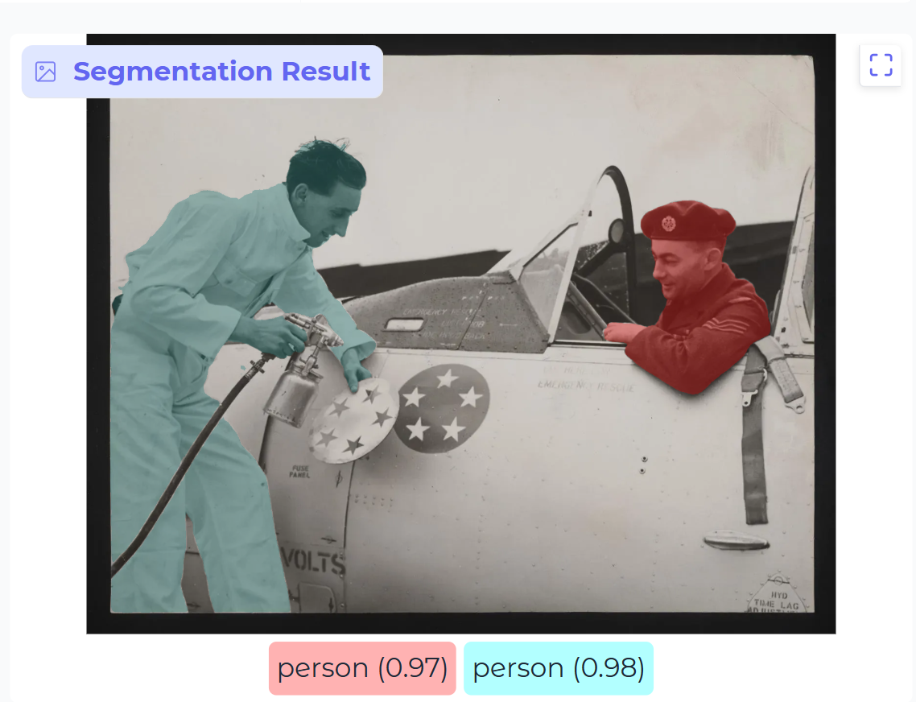
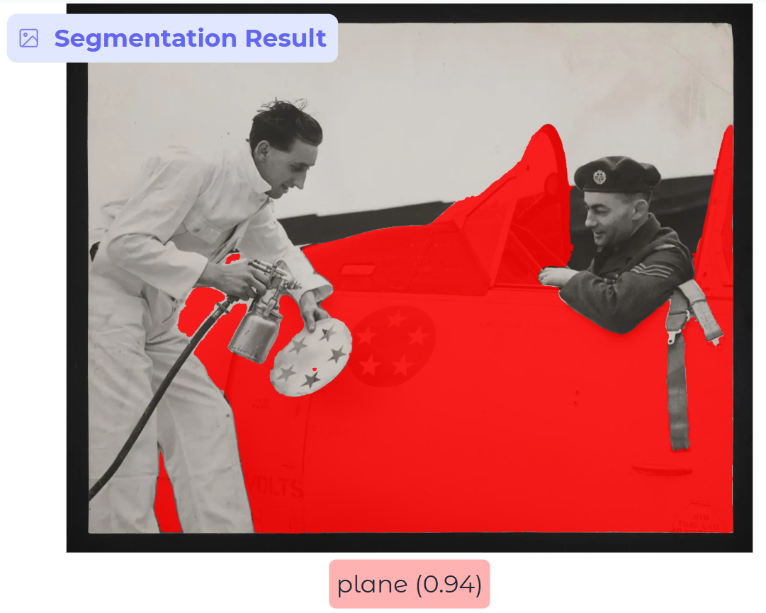
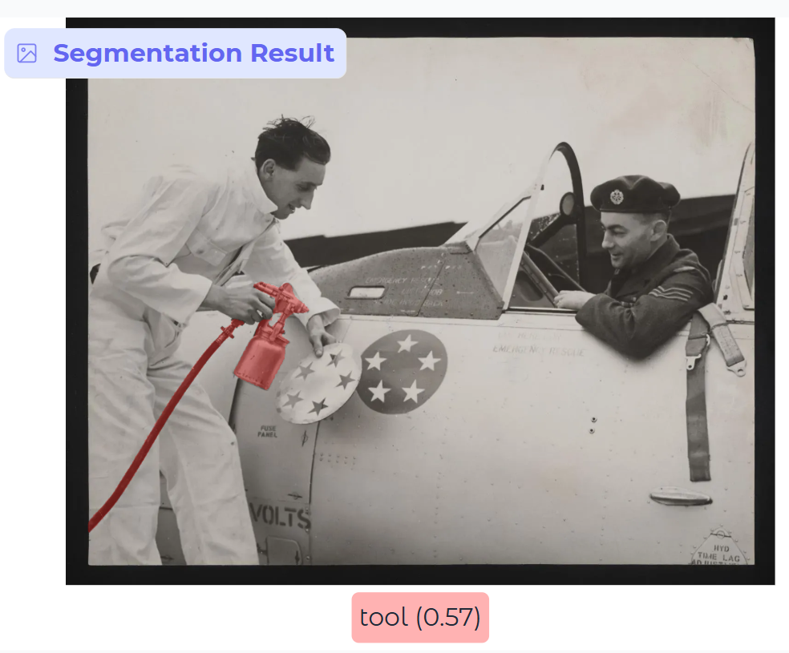
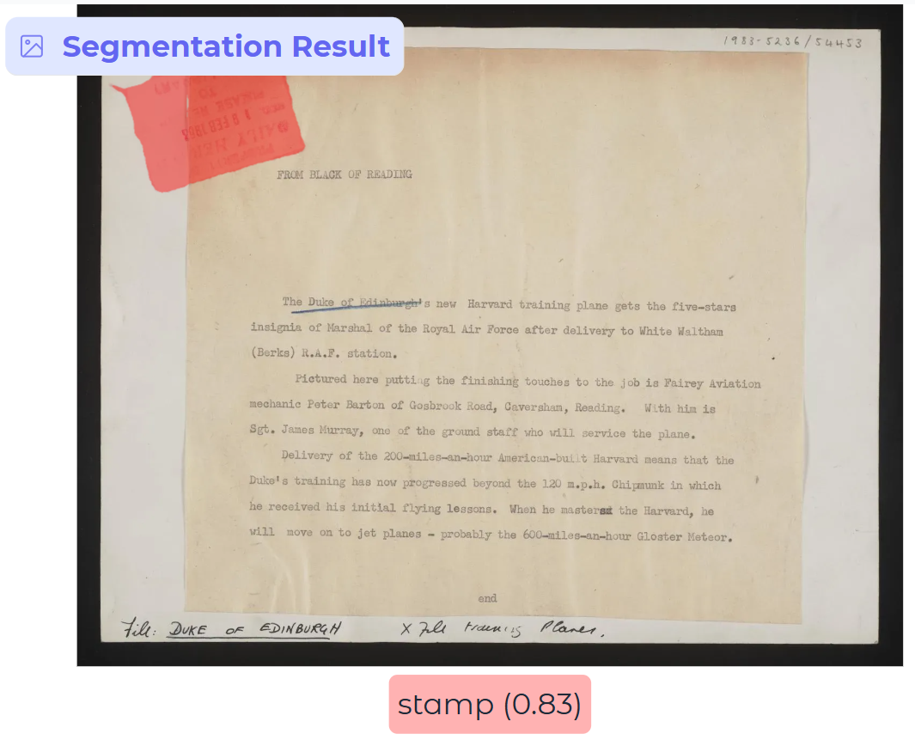
DAILY HERALD
Detection of visual elements on the front of images (Segment Anything 3 by Meta)
Better discoverability & easier identification of items for commercial purposes (SSPL)
Detecting (and classifying) stamps on backs of photographs
Helping copyright identification
Identifying entities (e.g. location names, people names, dates, events etc.) mentioned in transcriptions
Better search discoverability (information gap) & identification of harmful content & easier analysis

Slide 9

THANK YOU!
ANY QUESTIONS?

